Slide 1
Data Structures and Algorithms CSC211 Unit 6:Sorting
Shyam Sunder Khatiwada

Slide 2
Introduction
Sorting refers to ordering data in an increasing or decreasing manner according to some linear relationship among the data items.
Sorting algorithm is used to arrange elements of an array/list in a specific order(ascending/descending).
By sorting, it is easier to search through it quickly and easily.
The simplest example of sorting is dictionary.

Slide 3
Types:
Stable Sorting and Unstable Sorting
Internal Sorting and External Sorting.

Slide 4
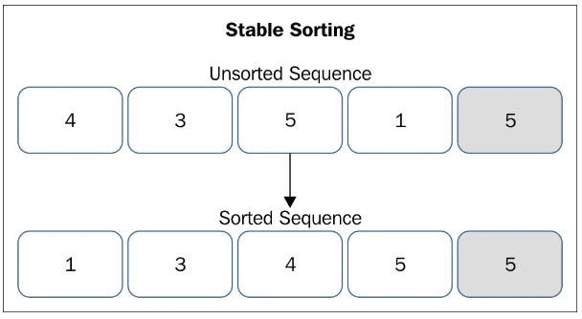
Stable sorting vs Unstable sorting
A stable sort algorithm maintains the relative ordering of elements of equal values in a sorted sequence. It can be understood using the following diagram
As the diagram depicts, our unsorted list has two fives. The first 5 is in a white slot and the second one is in a gray slot. After sorting, in the sorted sequence also, the 5 in the white slot remains before the 5 in the gray slot.

Slide 5
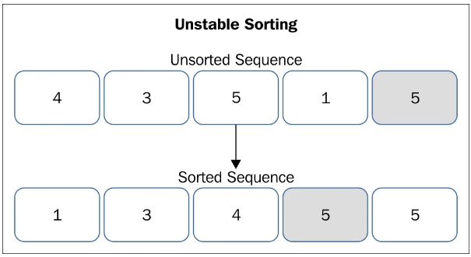
Stable vs Unstable Sorting
Unstable sorting algorithms do not maintain the relative ordering of elements of equal values in a sorted sequence. The diagram will help in understanding unstable sorting.
As in diagram, the 5 in a gray slot is before the 5 in white slot. In the unsorted sequence, the 5 in white slot is before the 5 in gray slot. After sorting, in the sorted sequence, their relative ordering is changed.

Slide 6
Internal Sorting vs External Sorting
Internal sorting:
When all the data placed in the main memory or internal memory then sorting is called internal sorting.
In internal sorting, the problem cannot take input beyond its size.
Example- Heap sort, bubble sort, selection sort, quick sort,shell sort, insertion sort

Slide 7
Internal Sorting vs External Sorting
External Sorting:
When all the data that needs to be sorted cannot be placed in main memory at a time, the sorting is called external sorting.
It is used for the massive amount of data.
Merge sort and its variations are typically used for external sorting.
Some external storage like hard disks and CDs are used for external sorting.
Example- Merge sort, Tag sort, Polyphase sort etc.

Slide 8
Insertion Sort
Insertion sort is a simple algorithm that works by iteratively inserting each element of an unsorted list into its correct position in a sorted portion of the list.
It is a stable sorting algorithm, meaning that elements with equal values maintain their relative order in the sorted output.
It is like sorting playing cards in your hands. It is assumed that the first card is already sorted in the card game, and then we select and unsorted card.
If the selected unsorted card is greater than the first card, it will be placed at the right side; otherwise, it will be placed at the left side

Slide 9
Algorithm
Step 1 - If the element is the first element, assume that it is already sorted. Return 1.
Step2 - Pick the next element, and store it separately in a key.
Step3 - Now, compare the key with all elements in the sorted array.
Step 4 - If the element in the sorted array is smaller than the current element, then move to the next element. Else, shift greater elements in the array towards the right.
Step 5 - Insert the value.
Step 6 - Repeat until the array is sorted.

Slide 10
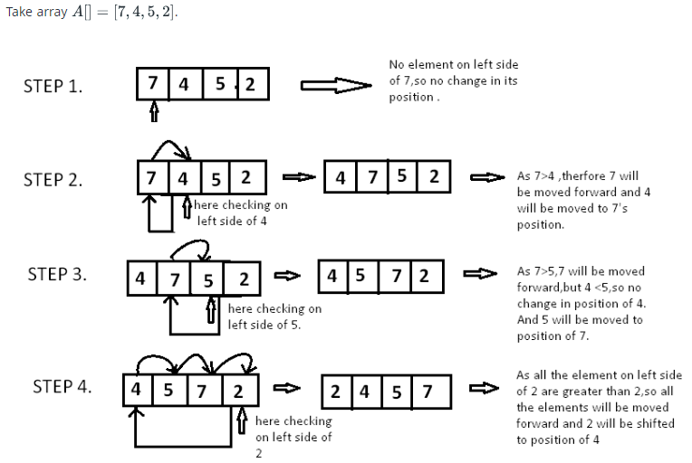
Example: Insertion Sorting

Slide 11
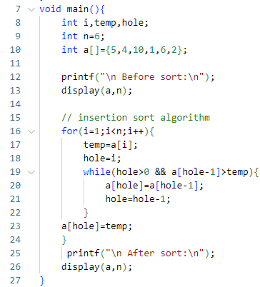
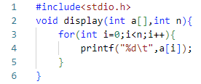
Code:

Slide 12
Selection Sort
The selection sort algorithm is a simple, yet effective sorting algorithm.
A selection based sorting algorithm is described as an in-place comparison-based algorithm that divides the list into two parts.
The sorted part on the left and unsorted part on the right.
Initially, the sorted section is empty, and the unsorted section contains the entire list.
when sorting a small list, selection sort can be used.

Slide 13
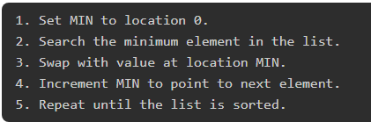
Algorithm:

Slide 14
Example

Slide 15
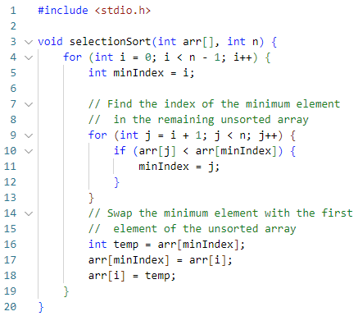
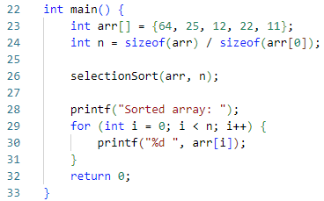
Code: Selection Sort

Slide 16
Bubble Sort:
Bubble sort is a sorting algorithm that compares two adjacent elements and swaps them until they are in the intended order.
Just like the movement of air bubbles in the water that rise up to the surface, each element of the array move to the end in each iteration. Therefore, it is called a bubble sort.
Although it is simple to use, it is primarily used as an educational tool because the performance of bubble sort is poor in the real world.
It is not suitable for large data sets.

Slide 17
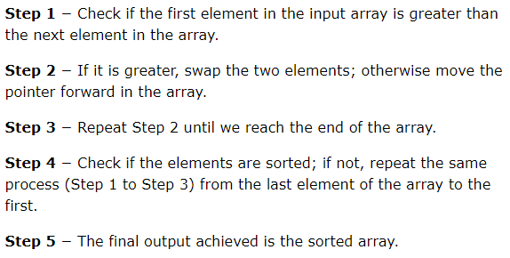
Algorithm

Slide 18
Example

Slide 19
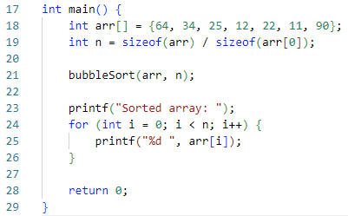
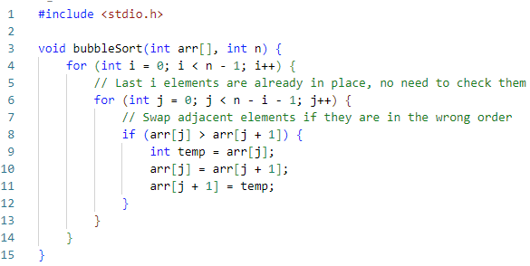
Code:

Slide 20
Quick sort
Quick sort is a sorting algorithm based on divide and conquer approach where:
An array is divide into subarrays by selecting pivot element.
while dividing the array, the pivot element should be positioned in such a way that elements less than pivot are kept on the left side and elements greater than pivot are on the right side of the pivot.
The left and right subarrays are also divided using the same approach. This process continues until each subarray contains a single element.
At this point, elements are already sorted. Finally, elements are combined to form a sorted array.

Slide 21
Choosing pivot element
Picking a good pivot is necessary for the fast implementation of quicksort. However it is typical to determine a good pivot. some of the ways of choosing a pivot are as follows:
pivot can be random, i.e. select the random pivot from the given array.
pivot can either be the rightmost element or leftmost element of the given array.
select median as the pivot element.
Note: we are considering the leftmost element of the given array in this topic.

Slide 22
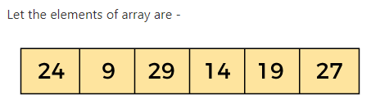
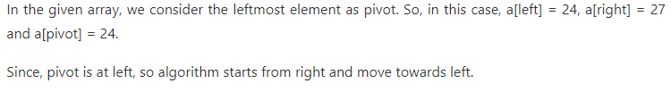
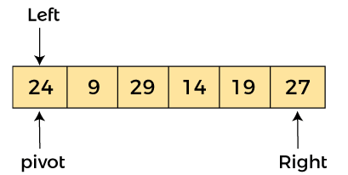
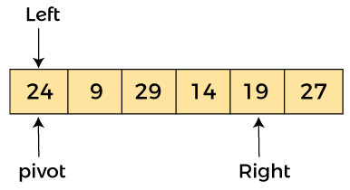
Example
Now, a[pivot] < a[right], so algorithm moves forward one position towards left, i.e. -

Slide 23
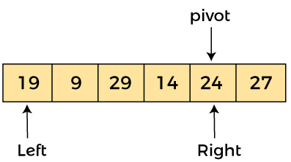
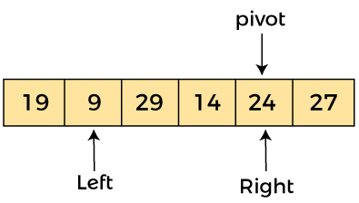
Example
Now, a[left] = 24, a[right] = 19, and a[pivot] = 24.
Because, a[pivot] > a[right], so, algorithm will swap a[pivot] with a[right], and pivot moves to right, as -
Now, a[left] = 19, a[right] = 24, and a[pivot] = 24. Since, pivot is at right, so algorithm starts from left and moves to right.
As a[pivot] > a[left], so algorithm moves one position to right as -

Slide 24
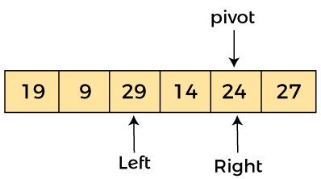
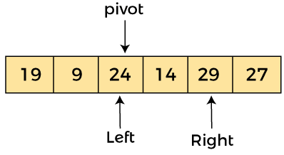
Example
Now, a[left] = 9, a[right] = 24, and a[pivot] = 24. As a[pivot] > a[left], so algorithm moves one position to right as -
Now, a[left] = 29, a[right] = 24, and a[pivot] = 24. As a[pivot] < a[left], so, swap a[pivot] and a[left], now pivot is at left, i.e. -

Slide 25
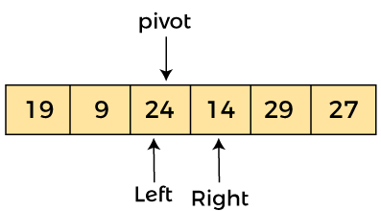
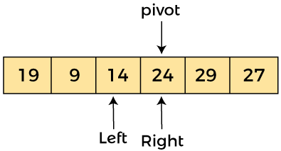
Example
Since, pivot is at left, so algorithm starts from right, and move to left. Now, a[left] = 24, a[right] = 29, and a[pivot] = 24. As a[pivot] < a[right], so algorithm moves one position to left, as -
Now, a[pivot] = 24, a[left] = 24, and a[right] = 14. As a[pivot] > a[right], so, swap a[pivot] and a[right], now pivot is at right, i.e. -

Slide 26
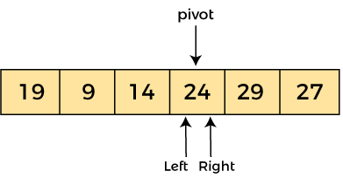
Example
Now, a[pivot] = 24, a[left] = 14, and a[right] = 24. Pivot is at right, so the algorithm starts from left and move to right.
Now, a[pivot] = 24, a[left] = 24, and a[right] = 24. So, pivot, left and right are pointing the same element. It represents the termination of procedure.
Element 24, which is the pivot element is placed at its exact position.

Slide 27
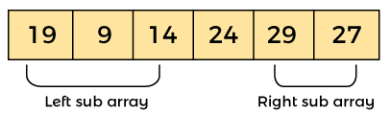

Example
Elements that are right side of element 24 are greater than it, and the elements that are left side of element 24 are smaller than it.
Now, in a similar manner, quick sort algorithm is separately applied to the left and right sub-arrays. After sorting gets done, the array will be -

Slide 28
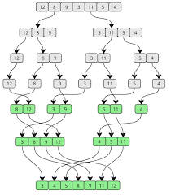
Merge Sort
Merge sort is a sorting algorithm that follows the divide-and-conquer approach.
It works by recursively dividing the input array into smaller subarrays and sorting those subarrays then merging them back together to obtain the sorted array.
In simple terms, we can say that the process of merge sort is to divide the array into two halves, sort each half, and then merge the sorted halves back together.
This process is repeated until the entire array is sorted.

Slide 29
How does Merge sort work
Merge sort is popular sorting algorithm known for its efficiency and stability. It follows the divide-and- conquer approach to sort a given array of elements.
Here’s a step-by-step explanation of how merge sort works:
Divide: Divide the list of array recursively into two halves until it can no more be divided.
Conquer: Each subarray is sorted individually using the merge sort algorithm.
Merge- The sorted subarrays are merged back together in sorted order. The process continues until all elements from both subarrays have been merged.

Slide 30
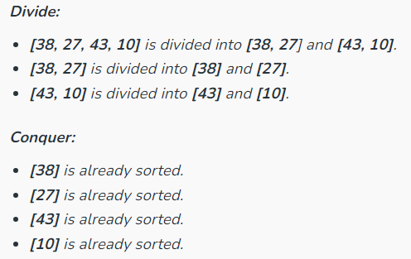
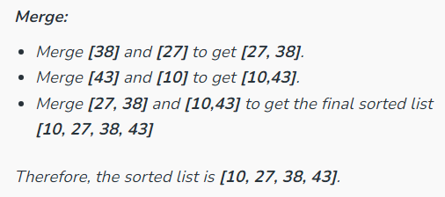
Example
Let’s sort the array or list [38, 27, 43, 10] using Merge Sort

Slide 31
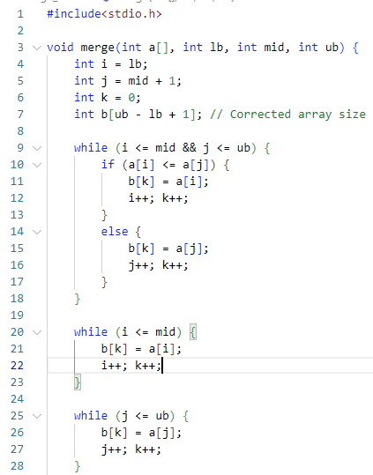
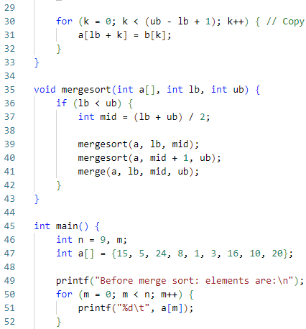
Code: Merge Sort

Slide 32
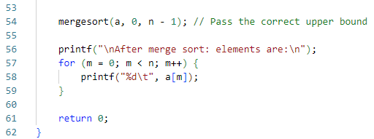
Code: Merge Sort

Slide 33
Shell Sort
Shell sort is a highly efficient sorting algorithm and is based on insertion sort algorithm.
This algorithm avoids large shifts as in case of insertion sort, if the smaller value is to the far right and has to be moved to the far left.
This algorithm uses insertion sort on a widely spread elements, first to sort them and then sorts the less widely spaced elements.
This spacing is termed as interval.

Slide 34
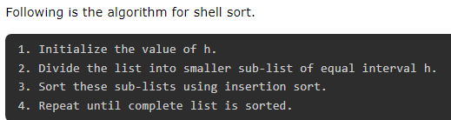
Shell Sort Algorithm

Slide 35
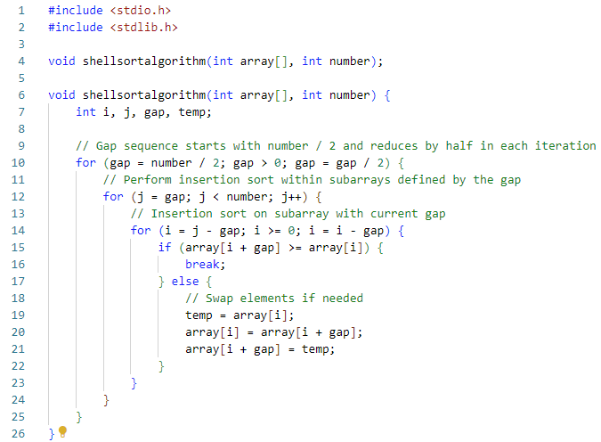
Code:

Slide 36
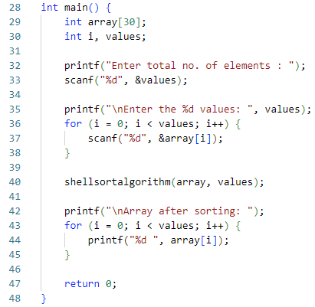
Code:

Slide 37
The ~End

